Slide 1
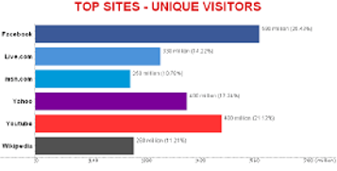
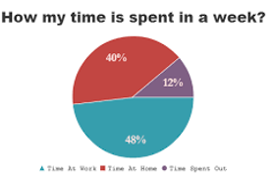
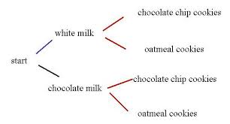
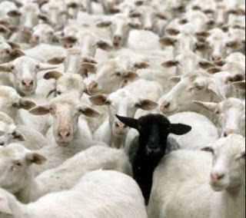
Characteristics of Distributions
Dr. Abolfazl Saghafi
Assistant Professor of Statistics & Data Science
Data Science Program Director
Part 3
Freq
Rel. Cum. Freq %
16
15
9
6
4
2
3
4
5
6
Outcome
Notes:
In this section we discuss general characteristics of distributions, provide some tools to describe them, and set some definitions to compare different distributions
After going over the slides come back to this page, what does that photo remind you of?

Slide 2
Characteristics
Important location characteristics are
1. Central Tendencies
2. Quantiles
Three important characteristics of a distribution are described by
Spread characteristics are measured using various measures including
1. Range
2. IQR
3. Variance & Standard Deviation
1. Location: showing where a distribution is located relative to observed values
2. Spread: provides a measure of dispersion or variability in a distribution
3. Shape: the symmetry (balance), asymmetry (skewness), and general shape of a distribution
Shape of a distribution is expressed using
1. Skewness
2. Outliers

Slide 3
Location: Central Tendencies
Mode, Median, and Mean (among others) are three most famous measures of central tendency.
2
3
4
5
6
7
8
Most frequently observed value.
Mode
A value that is greater than 50% of the observed values (midpoint of the data).
Usually known as average, it is sum of all data divided by number of data points (equal weights).
median
mean

Slide 4
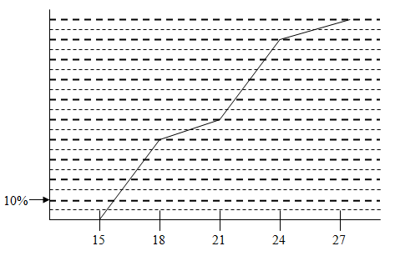
Location: Quantiles
Q ₂ is the same as median and P₅₀
Quartiles: After sorting the data, Q1, Q2 and Q3 are the first, second and third quartile, respectively, greater than 25%, 50% and 75% of the observed values.
You can also find the quantiles using an ogive graph by crossing the chart at certain percentages on y-axis (RCF%). Find P₁₀ in the following chart
P10
Q1
Q2
Q3
10%
50%
25%
Percentiles: After sorting, a value that is greater than a given percent of the observed values; median is the 50th percentile.
Notes:
We will practice computing these measures next week

Slide 5
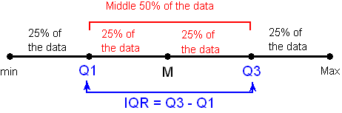
Spread
All these measures EXCEPT Variance have the same unit as the data.
Some important spread or discrepancy measures are
Unit of variance is
(unit of data)²
Range: Maximum – minimum
Inter-Quartile Range (IQR): Q3 – Q1
Variance: Squared Deviations from mean
Standard Deviation: Square-Root of Variance
Notes:
We will practice computing these measures next week

Slide 6
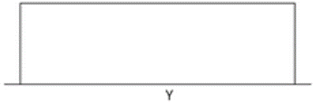
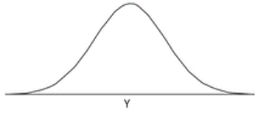
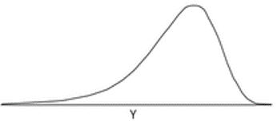
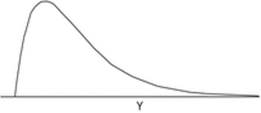
Shape: General Shape
Some common shapes are
Uniform (flat): where the observed values occur with roughly equal frequencies.
Bell-shaped: where the distribution resembles a bell . In this case, the mean, median and mode are equal.
Symmetric: there is an axis about which the form of the distribution is congruent.
Skewed: where one tail of the distribution is longer.
Skewed Left:
mean < median < Mode
Skewed Right:
Mode < median < mean

Slide 7
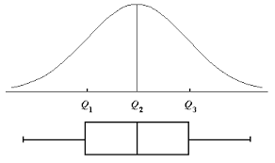
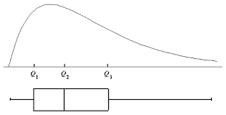
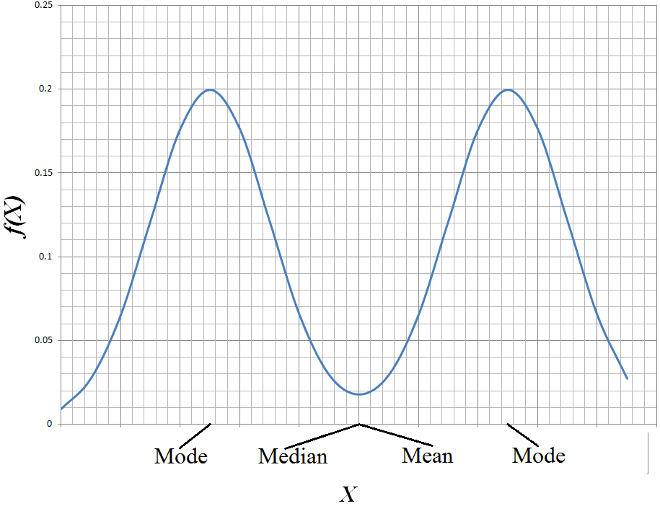
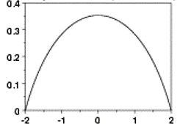
Example
Describe the shape of the given distributions.
Notes:
The four left charts are all skewed to the right. The rest are symmetric. The top right charts are bell-shaped. Bottom right is bimodal. Bottom center is humpy.

Slide 8
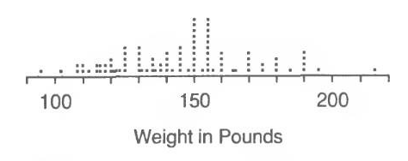
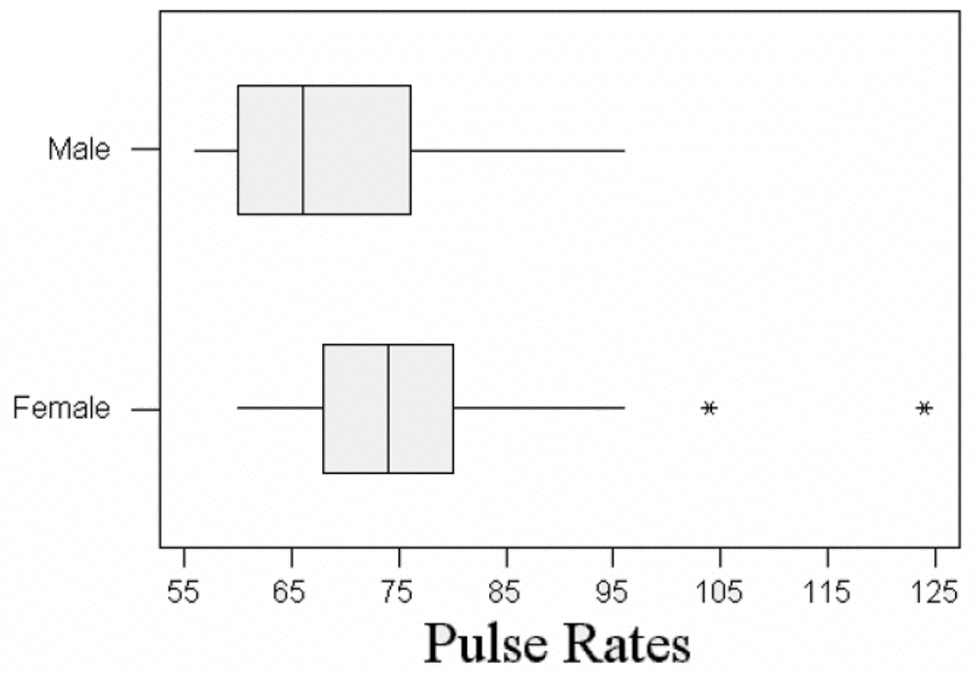
Shape: Outliers
Outliers are observations that fall outside the overall pattern (cluster) of the data.
To detect outliers, compute the following interval. Any point outside the interval is an outlier.
(Q₁–(1.5×IQR), Q₃+(1.5×IQR))
IF the distribution is bell-shaped and symmetric, any point outside the following interval is an outlier.
(μ-3σ, μ+3σ)
mean
Standard deviation
Describe and compare the above boxplots.
Notes:
That encircled observation is an outlier since it is farther away from the rest of the observations. We can easily detect outliers in some plots. To detect them within the data, generate one of the above two intervals (the first one is preferred) and see if any observation falls outside the interval.
The side-by-side box plot shows pulse rates for a group of male and female athletes. Females seem to have higher pulse rates as their Q1, median, Q2 are higher than males. There are two outliers in female pulse rates. These two are detected using the same discussed intervals. The spread in male pulse rates is greater than females considering IQR.

Slide 9
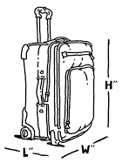
Exercise
The following numbers show a random sample of 13 airline carry-on luggage weights rounded to the nearest pound.
10 12 19 8 12 17 7 21 10 12 16 6 12
a) Compute the five number summary
b) Compute the Inter-Quartile Range
c) Draw the associated box plot
d) Comment on the shape of the distribution (symmetric - skewed left - skewed right - bell shaped)?
e) Are there any outliers?

Slide 10
Answer
6 7 8 10 10 12 12 12 12 16 17 19 21
Q1 = 9
Median = 12
Q3 =16.5
IQR = 16.5 - 9 = 7.5
Q1 – (1.5*IQR) = 9 – 11.25 = -2.25
Q3 + (1.5*IQR) = 16.5 + 11.25 = 27.75
(-2.25 , 27.75)

Slide 11
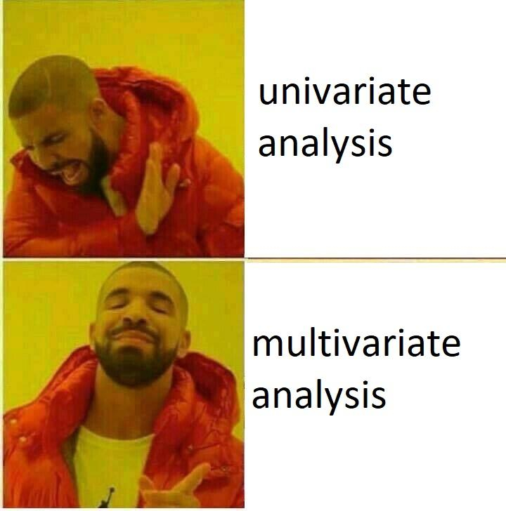
Bivariate Graphs
Part 3
Notes:
In many situations, researchers collect information on more than one variable from each individual. We normally start by summarizing information on each variables separately (univariate analysis). This will give us insight into each variables and help us detect unusual observations (outliers, missing, …). Then we move to summarize information on multiple variables at once. Many variables are tangled and have interactions. Height and weight for each individual for example are associated; age is associated with height and weight etc. Using multivariate data summarization techniques we can see these relationships and make reasonable hypothesis to test later.
In this section, we mention techniques to capture and illustrate bivariate associations. You’ll use this section later in your project.

Slide 12
Combination of Variables
The Response or Dependent Variable is the outcome of a study; a variable you are interested in predicting or estimating.
When trying to explore and describe information from two variables, we have different options depending on the type of response and predictor variables.
The Predictor or Independent Variable is used to explain and predict the response variable.
Response Variable
Categorical Numerical
Side-by-Side Box Plots
Scatterplot
Graphing side-by-side box plots is discussed in the lab session. Scatterplots is practiced later in regression chapter.
Predictor Variable
Categorical Numerical
Cross-Table
Grouped Bar chart
Side-by-Side Box Plots
Notes:
The type of illustrative chart depends on the type of both response and predictor variable. Use this guideline to generate proper graphs.

Slide 13
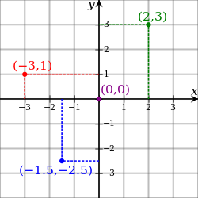
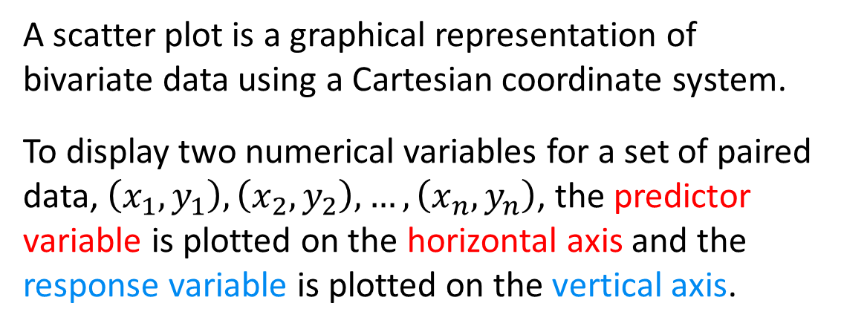
Scatterplot
A scatter plot is a graphical representation of bivariate data using a Cartesian coordinate system.
To display two numerical variables for a set of paired data, $\left(x_{1},y_{1}\right),\left(x_{2},y_{2}\right),…,\left(x_{n},y_{n}\right)$, the predictor variable is plotted on the horizontal axis and the response variable is plotted on the vertical axis.
Upon graphing a scatterplot we investigate
• the overall pattern of the plotted points
• the direction and shape of the pattern (if any)
• whether there are any outliers
On scatterplots each dot represents bivariate information for one sample unit.

Slide 14
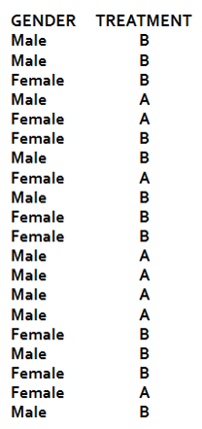
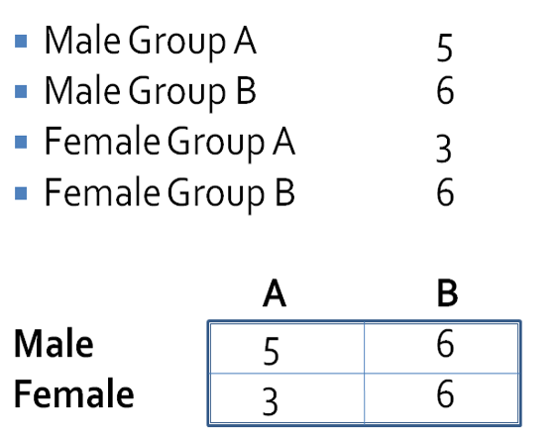
Cross Table
This table can be generated in excel easily using Pivot table tools.
A Cross table is a frequency distribution for a two variables at once.
1. One variable is assigned to horizontal axis and one to vertical.
2. Joint counts within each combination of categories is placed on a matrix formation.
Notes:
Just like a typical frequency table, count the number of observations within each of the four possible categories generated by variables Gender and Treatment. Then present the counts in a matrix form for each possible combination of the variables.

Slide 15
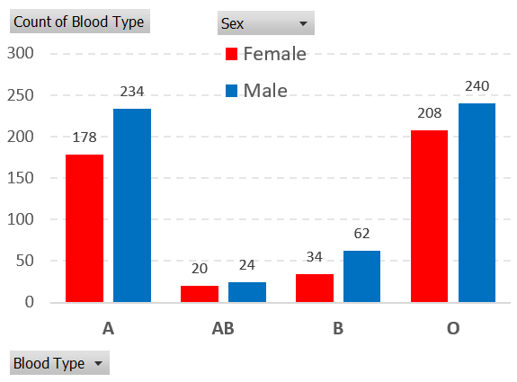
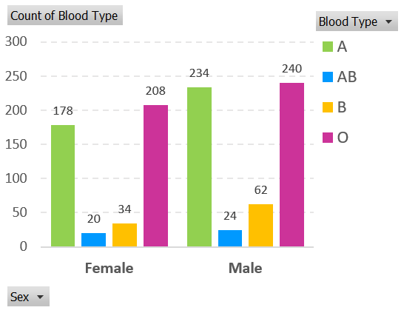
Grouped Bar Charts
Similar to bar charts, x-axis is divided into groups depending on different combinations of the response and predictor variables. Then, a bar is graphed with height proportional to frequency of observations in each combination.
In this example, Sex is the response variable and Blood type is the predictor. Do you see any relationships? Explain.
This chart can be graphed in excel using Pivot table tools after dragging one variable into column and one into row space.
Notes:
The two versions of this grouped bar chart represent the same information. Since we are interested in comparing the response variable (Sex) for given predictors, the first chart seems to be easier to investigate.

Slide 16
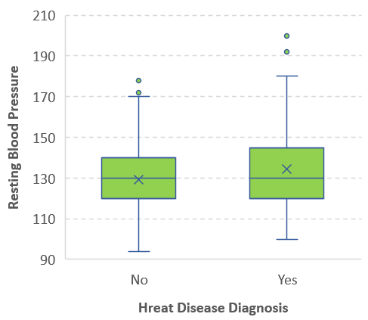
Side-by-side Box Plots
This chart can be graphed in excel using insert chart menu.
Box plots generated for levels of a qualitative variable are used to investigate association between a qualitative and quantitative variable.
Notes:
The response variable in the box plots on the left is the pulse rate which is numerical. It is obvious that the pattern of pulse rate is different between the two genders.
In the box plot on the right, the response is quantitative, whether people had diagnosed with heart disease. The Predictor variable is resting blood pressure. This boxplot also shows a six numerical number, the mean, which is shown by x on the chart.

Slide 17
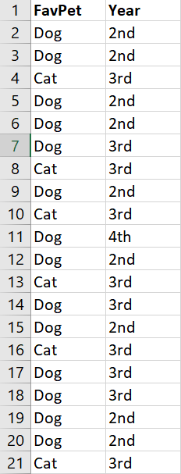
Exercise
The data shows sample results of the class survey on Two variables, Favorite Pet and Year into program. Generate a Cross Table and graph a suitable chart.

Slide 18
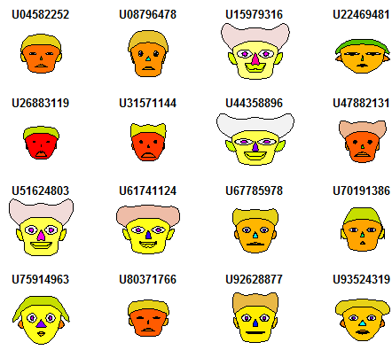
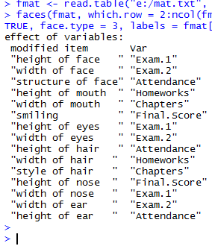




Multivariate Graphs
There are creative ways to illustrate many variables all at once in one chart. Chernoff faces is one of them.
Notes:
There are creative ways to illustrate more than two numerical variables all at once in one chart. Chernoff faces is one of them. In here each face represent information on 15 numerical variables! The interesting thing is that you can easily recognize which cases have similar values within what variables.

Slide 19

Practice Problems Part 3
1. We are interested to investigate whether the Red Blood Cell (RBC) counts is different among two Old (more than 50) and Young (less than 25) people. The following is a sample data collected to investigate this relationship.
a) Graph a suitable bivariate chart to illustrate the provided data.
b) Describe the chart in terms of shape characteristics.
Age Group | Y | O | Y | O | O | O | Y | Y | Y | O | Y | Y | O | O | Y | O | Y
RBC | 7.4 | 4.7 | 7.5 | 6.9 | 3.7 | 5.0 | 5.6 | 5.7 | 4.8 | 6.8 | 5.2 | 5.1 | 5.6 | 4.7 | 6.1 | 3.8 | 7.5
Notes:
Answers are provided in Ch2 Practice Problem Solutions

Slide 20
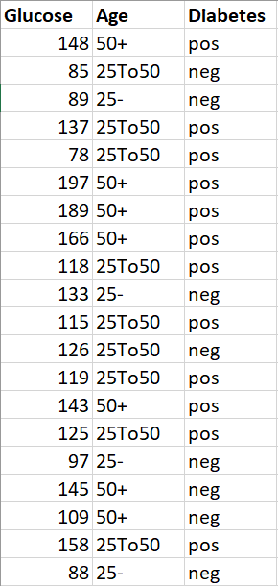
Practice Problems Part 3
2. The table shows information on Glucose level, Age group (25-, 25To50, 50+) and Diabetes status for a random sample of 20 patients.
a) Explain which of the variables is response and which is predictor?
b) Generate a cross table representing information on Age groups and diabetes status.
c) Graph a suitable chart illustrating bivariate information on Age groups and diabetes status. Describe the chart in terms of shape and any interesting patterns.
c) Is Glucose level related to Diabetes status? Investigate any relationship using a proper chart.
Notes:
Answers are provided in Ch2 Practice Problem Solutions

Slide 21
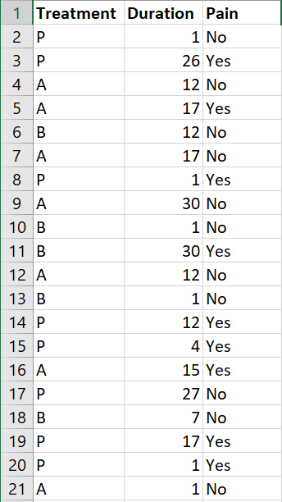
Practice Problems Part 3
3. The table provides data on Treatment (A/B/Placebo), Duration of Neuroglia, experience of Pain for a random sample of 20 patients.
a) Generate a cross table representing information on Treatment and Pain.
b) Graph a suitable chart illustrating bivariate information on Treatment and Pain. Describe the chart in terms of shape and any interesting patterns.
c) Is Duration of Neuroglia related to experience of Pain? Investigate any relationship using a proper chart.
Notes:
Answers are provided in Ch2 Practice Problem Solutions

